Slide 1
Collections

Slide 2
Website
Go to:
My.HRW.com

Slide 3
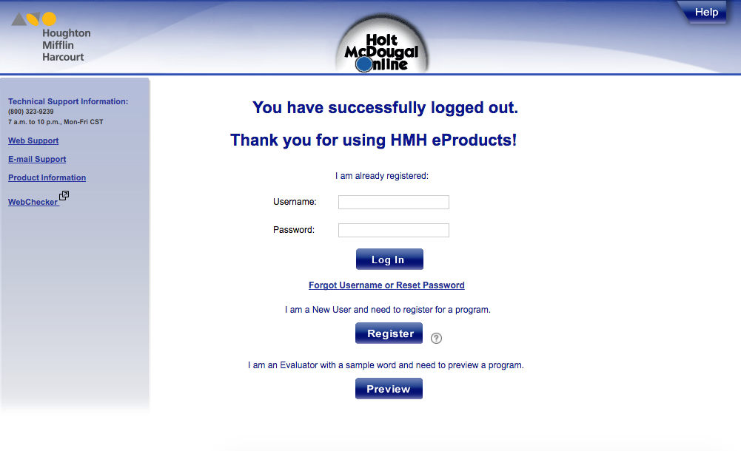

Slide 4
Home Screen
Please add this link to your Home Screen
You may name it “HRW” or “Collections”

Slide 5
Log In
Username:
“L” + Lunch number
Example: L12345

Slide 6
Log In
Password:
First Name; Capitalize the first letter
Example: Caleb, Jordan, Wyatt
If your name is less than FIVE letters, add in letters from your last name
Ex: RyanC, NoahM, MyaSp

Slide 7
Log In
Password:
First Name; Capitalize the first letter
Example: Victoria, Abigail, Jordan
If your name is less than FIVE letters, add in letters from your last name
Ex: CodyC, KaraM, JohnR, ReedS, PaulT

Slide 8
Log In
Password:
First Name; Capitalize the first letter
Example: Katelyn, William, Carson
If your name is less than FIVE letters, add in letters from your last name
Ex: EmmaD, EliDr, JadaF, KoleS

